Slide 1
Transaction Processing concepts, Concurrency Control and Recovery
PART 3

Slide 2
Objectives of the Lecture
Discuss database recovery issues:
Recovery from catastrophic (like disc crash) failure, and
recovery from a non-catastrophic failure

Slide 3
Requirements for Database Consistency - recall
Concurrency Control
The concurrent execution of many different transactions submitted by various users must be organized such that each transaction does not interfere with another transaction in a way that produces incorrect results. i.e. the concurrent execution of transactions must be such that each transaction appears to execute in isolation.
Recovery
System failures, either hardware or software, must not result in an inconsistent database

Slide 4
Transaction as a Recovery Unit
If any of the below occurs between the begin and end of a transaction, the database will be inconsistent!
Computer Failure (system crash)
A transaction or system error
Local errors or exception conditions detected by the transaction
Concurrency control enforcement
Disk failure
Physical problems and catastrophes
The database is restored to some state from the past so that a correct state—close to the time of failure—can be reconstructed from the past state.
The statements COMMIT and ROLLBACK (or their equivalent) ensure Transaction Atomicity

Slide 5
Transaction as a Recovery Unit(2)
A DBMS ensures that if a transaction executes some updates and then a failure occurs before the transaction reaches normal termination, then those updates are undone.
A DBMS also ensures that if a transaction executes some updates and commits, then a failure occurs thereafter, then those updates are redone.

Slide 6
Why “Database Recovery Techniques”?
System crash
Transaction error
System error
Local error
Disk failure
Catastrophe
Crash
T1
T2
T3
Time
ACID properties of Transaction
Database system should guarantee
Durability : Applied changes by transactions
must not be lost. ~ T1, T2
Atomicity : Transactions can be aborted.
~ T3

Slide 7
Classification of failures
According to type of the failure recovery procedures classify to:
Recovery from catastrophic (like disc crash) failure, and
recovery from a non-catastrophic failure
Catastrophic failure:
Restore from a previous copy of the database from archival backup.
Apply transaction log to backup copy to reconstruct more current state by redoing committed transaction operations up to failure point

Slide 8
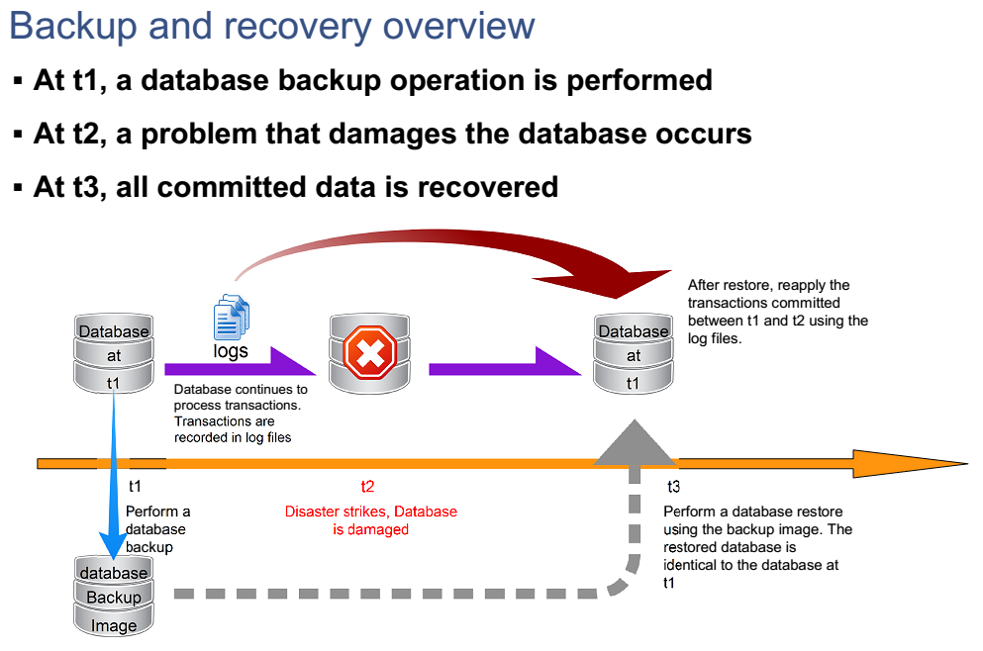
Recovery from Catastrophic failure:

Slide 9
Recovery from Catastrophic failure
Full DB Backup
> Differential Backup
> (Transaction) Log
Catastrophic failure
You should read on different strategies/types of backup
Full
Incremental
differential

Slide 10
Non-catastrophic failures
A computer failure
Hardware failure
Software failure
Network failure
A transaction error
Integer overflow
Division by zero
Logical error
Exception condition
User interruption
Concurrency control enforcement
Violated serializability
deadlock

Slide 11
Non-catastrophic failure recovery
Assumes that data on disk is safe (thus only considers recovery from non-disk failures)
Generally, if a DB becomes inconsistent due to a non-catastrophic failure, the idea is to reverse those changes that make it inconsistent.
Recovery can be based on many algorithms including:
Deferred update
Immediate update and
Shadow paging

Slide 12
Basic Concepts : “Logging”
Backup
Checkpoint
System Log
- keeps info of changes applied by transactions
T1
Crash
T2
T3
Time
Undo/Redo done using the Log
→ recover Non-catastrophic failure

Slide 13
Transaction and System Concepts
The System Log
Log or Journal: The log keeps track of all transaction operations that affect the values of database items.
This information may be needed to permit recovery from transaction failures.
The log is kept on disk, so it is not affected by any type of failure except for disk or catastrophic failure.
In addition, the log is periodically backed up to archival storage (tape) to guard against such catastrophic failures.

Slide 14
Transaction and System Concepts (2)
The System Log (cont):
T in the following discussion refers to a unique transaction-id that is generated automatically by the system and is used to identify each transaction:
Types of log record:
[start_transaction,T]: Records that transaction T has started execution.
[write_item,T,X,old_value,new_value]: Records that transaction T has changed the value of database item X from old_value to new_value.
[read_item,T,X]: Records that transaction T has read the value of database item X.
[commit,T]: Records that transaction T has completed successfully, and affirms that its effect can be committed (recorded permanently) to the database.
[abort,T]: Records that transaction T has been aborted.

Slide 15
Transaction and System Concepts (3)
The System Log (cont):
Protocols for recovery that avoid cascading rollbacks do not require that read operations be written to the system log, whereas other protocols require these entries for recovery.
Strict protocols require simpler write entries that do not include new_value.

Slide 16
Transaction and System Concepts (4)
Recovery using log records:
If the system crashes, we can recover to a consistent database state by examining the log
Because the log contains a record of every write operation that changes the value of some database item, it is possible to undo the effect of these write operations of a transaction T by tracing backward through the log and resetting all items changed by a write operation of T to their old_values.
We can also redo the effect of the write operations of a transaction T by tracing forward through the log and setting all items changed by a write operation of T (that did not get done permanently) to their new_values.

Slide 17
Entries in the System Log
For every transaction a unique transaction-id is generated by the system.
[start_transaction, transaction-id]: the start of execution of the transaction identified by transaction-id
[read_item, transaction-id, X]: the transaction identified by transaction-id reads the value of database item X. Optional in some protocols.
[write_item, transaction-id, X, old_value, new_value]: the transaction identified by transaction-id changes the value of database item X from old_value to new_value
[commit, transaction-id]: the transaction identified by transaction-id has completed all accesses to the database successfully and its effect can be recorded permanently (committed)
[abort, transaction-id]: the transaction identified by transaction-id has been aborted
Credit_labmark (sno NUMBER, cno CHAR, credit NUMBER)
old_mark NUMBER;
new_mark NUMBER;
SELECT labmark INTO old_mark FROM enrol
WHERE studno = sno and courseno = cno FOR UPDATE OF labmark;
new_ mark := old_ mark + credit;
UPDATE enrol SET labmark = new_mark WHERE studno = sno and courseno = cno ;
COMMIT;
EXCEPTION
WHEN OTHERS THEN ROLLBACK;
END credit_labmark;

Slide 18
Transaction execution
A transaction reaches its commit point when all operations accessing the database are completed and the result has been recorded in the log. It then writes a [commit, transaction-id].
BEGIN
END
TRANSACTION
TRANSACTION
active
partially
COMMIT
committed
committed
,
ROLLBACK
ROLLBACK
READ
WRITE
failed
terminated
If a system failure occurs, searching the log and rollback the transactions that have written into the log a
[start_transaction, transaction-id]
[write_item, transaction-id, X, old_value, new_value]
but have not recorded into the log a [commit, transaction-id]

Slide 19
Physical View - How they work - (1)
Memory
Disk
A
copy
DBMS cache
(buffers)
B
a
flush
Directory
B’
(address:A,a,1)
(address:B,b,0)
Disk pages/blocks
b
Action :
1) Check the directory whether in the cache
2) If none, copy from disk pages to the cache
3) For the copy, old buffers needs to be flushed
from the cache to the disk pages

Slide 20
Physical View - How they work - (2)
Memory
Disk
A
copy
DBMS cache
(buffers)
B
a
update
flush
Directory
B’
(address:A,a,1)
(address:B,b,0)
Disk pages/blocks
b
4) Flush only if a dirty bit is 1
Dirty bit : (in the directory) indicates whether there is
a change after copy to the cache
1 – updated in the cache
0 – not updated in the cache (no need to flush)

Slide 21
Physical View - How they work - (3)
Memory
Disk
A
copy
DBMS cache
(buffers)
B
a
flush
B’
Disk pages/blocks
b
A-a : “in-place updating”
- when flushing, overwrite at the same location
- logging is required
B-b : “shadowing”

Slide 22
Physical View - How they work - (4)
Memory
Disk
DBMS cache
B
copy
b
update
update
B’
Data
blocks
Log
blocks
Data blocks
flush
Log blocks
(1) copy (from the disk to the cache)
(2) update the cached data, record it in the log
(3) flush the log and the data
(from the cache to the disk)

Slide 23
Basic Concepts: Steal & No-Force (1)
Typical DB employs a steal/no-force strategy
Steal strategy : a transaction can be written to disk
before it commits
commit
T1
commit
T2
T3
Time
cache
cache
Can be Used for other transactions (T3)
Updated data by T2
Advantage :
buffer space saving
before T2 commits

Slide 24
Basic Concepts: Steal & No-Force (2)
No-Force strategy : a transaction need not be
written to disk immediately
when it commits
commit
Advantage :
I/O operations saving
T1
commit
T2
T3
Time
cache
cache
If T3 needs the same data, it must be copied again
Updated data by T2
← Force strategy
when T2 commits

Slide 25
Basic Concepts: Checkpointing
At a Checkpoint
- temporarily suspend all transactions
- Force write results of all update operations of committed transactions from memory to disk
- A record is written into the log file and log force written to disk. ([checkpoint])
- Resume executing transactions
Periodically done (e.g. every n min. or every n transaction)
Checkpoint
Crash
T1
T2
T3
Time

Slide 26
Transaction Rollback (1)
Rollback / Roll foward
Recovery method
Crash
1 : Not necesary
T1
T2
2 : Roll foward
T3
3 : Rollback
T4
4 : Roll forward
T5
5 : ignore
Time
Checkpoint
Steal : transaction may be written on disk
before it commits

Slide 27
Transaction Rollback (2)
example :
read(A)
write(A)
read(B)
write(B)
T1
read(A)
write(A)
read(C)
write(C)
T2
Time
Checkpoint
Crash
T1 : A company pays salary to employees
i) transfer $2,000 to Mr. A’s account
ii) transfer $2,500 to Mr B’s account …
Name | Account
Mr.A | $10
Mr.B | $2,000
Mr.C | $30,000
T2 : Mr.A pays the monthly rent.
i) withdraw $1,500 from Mr.A’s account
ii) transfer $1,500 to Mr.C’s account

Slide 28
Transaction Rollback (3)
Cascading Rollback
r(A)
w(A)
r (B)
T1
T1 is interrupted
(needs rollback)
r(A)
w(A)
w(C)
r(C)
T2
Checkpoint
Crash
System Log
[checkpoint]
[start_transaction, T1]
[read_item, T1, A]
[write_item, T1, A, 10, 2010]
[start_transaction, T2]
[read_item, T2, A]
[write_item, T2, A, 2010, 510]
[read_item, T1, B]
[read_item, T2, C]
[write_item, T2, C, 1500, 31500]
~~~ CRASH ~~~~
A
$10
$10
$2,010
$2,010
$510
C
$30,000
$30,000
$31,500
T2 uses value
modified by T1
(also needs
rollback)

Slide 29
Categorization of Recovery Algorithm
Deferred update – the No-UNDO/REDO algorithm
Immediate update –
the UNDO/REDO algorithm
UNDO/No-REDO

Slide 30
Deferred Update
Deferred Update:
Idea is that no actual update of the database until after a transaction reaches its commit point
1. During execution updates are recorded in log
2. Just before transaction commit point, all log updates are written to the log file in disk, and then the transaction commits.
3. After that, update the database
FAILURE!
REDO committed transaction to database from log entries
No UNDO necessary because database never altered

Slide 31
Immediate Update
Immediate Update general concept:
the database may be updated by some operations of a transaction before it reaches its commit point.
Thus an update X recorded in log is also leads to an update X in database
There are two versions:
one, where all updates are written to disk before transaction commits
Two, where transaction commits before all its updates are written to disk

Slide 32
Recovery Timeline
Notes:
Classification of transactions by time
- T1: started before checkpoint; completed before checkpoint
- T2: started before checkpoint; completed after checkpoint
- T3: started after checkpoint, completed before failure
- T4: started before checkpoint; not complete at failure time
- T5: started after checkpoint; not complete at failure time
Consistent state after failure:
- T1, T2, and T3 changes are on the database
- T4 and T5: no changes on the database

Slide 33
Recovery Processes summary
Depend on timing of database writes (force or no-force)
Immediate update approach:
Before commit
Log records written first (write-ahead log protocol)
Deferred update approach
After commit
Undo operations not needed
Notes:
Recovery processes for local and system failures depend on the timing of database writes
Immediate update approach:
- Database updates written when they occur
- Log records must be written to disk first
- Uses both undo and redo operations in the recovery process
- Checkpoint: write log buffers and database buffers
Deferred update approach:
- Database writes written to disk after commit
- Only redo operations are used
- No database writes of uncommitted transactions at checkpoint
- Checkpoint: database writes of committed transactions and log writes

Slide 34
Other methods for recovery
Shadow paging – read on your own

